Slide 1
Customer background
Customer is a global multinational consumer goods company with headquarters in United States of America.
Customer is present in around 250 countries and own more than 500 brands across food, condiments, ice cream, cleaning agents, beauty products, and personal care.
Customer is organized into three main divisions: Foods and Refreshments, Home Care, and Beauty & Personal Care
3 billion people use the customer’s products every day, being part of their daily life.
All the division are growing but are challenged by local, niche and sector specific brands and retailer’s own private labels.
Income statement for last 5 years
Metrics | 31.12.17(€m) | 31.12.18(€m) | 31.12.19(€m) | 31.12.20(€m) | 31.12.21(€m)
Total Revenue | 53,715.00 | 50,982.00 | 51,980.00 | 50,724.00 | 52,444.00
Operating profit | 8,857.00 | 12,535.00 | 8,638.00 | 8,295.00 | 8,666.00
Net profit | 6,486.00 | 9,808.00 | 6,026.00 | 6,073.00 | 6,621.00
PE Ratio | 21.57 | 13.15 | 23.88 | 22.89 | 20.15
Earnings per Share Growth | 18.36% | 62.04% | -38.57% | -1.20% | 9.69%

Slide 2
Needs/Challenges
Business needs/challenges
Impact of e-Influence -Important influence channel – more offline purchases being influenced online
Need to drive business momentum through deep understanding of the drivers
Differentiation in the CG market is difficult because producers can only compete in availability, range of products and prices.
Local regulations and compliance
Increase in Advertising spending are affecting margins
Competes with other huge companies like Unilever, P&G and Nestlé and local companies that try to dominate every market
Need for capability to help business not only to perform better analytics and insights, but also to help them in strategic decision making.
Efforts spent in doing the manual activities like extracting and cleansing of data from different data sources and creating manual KPI dashboards out of it.
Need for capability to perform predictive analytics and forecasting.
Digital transformation-based challenges with multiple applications to manage and not providing a unified view of products and other insights
Technical Challenges
And as the growth of data both internal and external grows exponentially, the traditional methods of storing vast volumes of data in a database or data warehouse are no longer sustainable or cost effective
Unavailability of platform to host all the data sets from different sources into one data repository
Challenges related to unextractable datasets from all different data sources resulting into not so accurate analytics
Global users with role-based access controls and security
Reduce the cost by consolidating data across various MPP database instances and reduce duplicate and proliferation of data across the platform. There is no general framework that could be adapted by different business units and geographies to onboard data to the current data platform
Performance issues across the board for batch workloads and also for data consumption from the platform through various BI tools
Client is embarking to strengthen and expand its analytics platform by using data from the on-premise MPP data warehouse, SAP HANA & MDM system to the cloud ecosystem for processing and to have supply chain analytics/analysis in place for effective management decisions.

Slide 3
Ask from the client
Use Insights and intelligence to differentiate themselves in the market with other large companies like Unilever, P&G and Nestlé and local companies.
Need for capability to help business not only to perform better analytics and insights, but also to help them in strategic decision making.
Use of data mesh principles to follow de-centralized, domain driven solution principles to enable “Faster time to market”
Roadmap of Platform features implementation and use-case implementation roadmap
General framework for data onboarding and data consumption
Meet the performance NFR’s for both real-time, batch jobs and for BI reports, data science and other type of workloads
Charge-back and business engagement models available as part of the operating model
Enable end to end data governance and use of data stewards effectively in the platform
Ensure high availability and disaster recovery
Role based access controls across geographies and business units.
Ingest Historical data (~5 years) to Cloud to create a global data lake and provide a framework to customize rules and KPI’s for local geographies and business units
Transform and curate the source data for consumption across the business units and geographies

Slide 4
Proposed solution and approach
Solution Architecture including technical architecture (both component level and deployment)
High level roadmap (Blueprint)
Development methodology recommendation and approach/framework
Estimates, Resource Plan and staffing model (with Work break down structure sheet)
Engagement Type and Costs
Delivery governance approach
Risks / Constraints/ Dependencies
Justification of the proposed solution
How the solution, our execution approach and the roadmap helps meet the business and technical needs of the customer?
How the solution helps meet the performance NFR’s and “Faster time to market”?
How the solution and the operating model helps reduce the over all TCO?
Expected slides:
Slide 1 : Executive Summary
a) Current challenges/issues
b) How new solution to address the challenges/issues
Slide 2: In Scope, Out of Scope and Assumptions
Slide 3: Proposed Technical Solution Architecture
Slide 4: Solution Architecture Layer/Component wise articulation
Slide 5: CICD (Deployment) Architecture
Slide 6: Estimation, Roadmap & Timeline, Pricing (with Detailed Work Breakdown Structure)
Slide 7: Team Structure
Slide 8: Execution Methodology
Slide 9: Risks and Dependency (Optional)

Slide 5
Agenda
Expected slides:
Slide 1 : Executive Summary
a) Current challenges/issues
b) How new solution to address the challenges/issues
Slide 2: In Scope, Out of Scope and Assumptions
Slide 3: Proposed Technical Solution Architecture
Slide 4: Solution Architecture Layer/Component wise articulation
Slide 5: CICD (Deployment) Architecture
Slide 6: Estimation, Roadmap & Timeline, Pricing (with Detailed Work Breakdown Structure)
Slide 7: Team Structure
Slide 8: Execution Methodology
Slide 9: Risks and Dependency (Optional)

Slide 6
Executive Summary
Current State & Challenges
Business scale, complexity and variability
Multinational CG company, 250 countries, 500 brands
Customer trust & outreach
3Bn people use products every day.
Leverage optimal sales channels.
ROI on Advertising
Safety
Regulations, laws, compliance
Competition
Unilever, P&G and Nestlé plus local, niche and sector specific brands and retailer’s own private labels.
Need for differentiation
Hence the need to strengthen supply chain analytics
Solution Highlights
Mesh Architecture
Domain-oriented decentralized data ownership and architecture
Data as a product
Self-service data infrastructure as a platform
‘Federated computational governance’ – global policies + flexibility for domain teams.
Rich data and processing foundation
Framework for data onboarding, curation and consumption
5+yrs data available for analytics
Compliance to regulations
Intelligence Enriched for Strategic Decision Making
Leverage 3rd party data on advertising (ex Nielsen), competitor financials (ex Bloomberg) etc
Planning, score-carding, dashboarding capabilities
Infrastructure for Gen AI implementation
Scalable Cloud Infrastructure
Unified technology roadmap
IAM/RBAC
Execution Highlights
- 7.5 months implementation to be done in fixed price
- Solution compliant to the mesh architecture concepts
Options available to leverage Generative AI in solution
Bring your own BI tool. UX designer for superior report designs

Slide 7
Scope of Work
Scope of Work
Analysis of client's information needs and current architecture
Documenting functional, non-functional requirements
Defining & documenting target information and technical architecture
Designing and development of data acquisition, curation and consumption components
System integration testing – planning and execution
Support UAT
Implement CI/CD pipelines
Go-live and deployment
Hypercare (4 weeks)
Out of Scope
Process re-engineering
Data cleansing/correction
Consolidating/standardising master data
Real time processing of data
Building AI/ML models
Implementing GenAI use cases
Building BI artefacts on tools other than QuickSight

Slide 8
Assumptions
While the company operates in several geographies, there is a one instance of MPP DW, SAP HANA and MDM system from which data will be sourced
AWS is a preferred cloud technology platform.
The client will provide access to the data and business SME’s within 3 days of it being requested
The client will address change management and training needs arising from this project

Slide 9

Conceptual Solution Architecture
Data Sources
Data Ingestion, Staging and Curation
SCM Data as a Product
Domain Agnostic Standards
DP1
Inventory
Inventory Microservices
Consumption Tools
DP2
Procurement
On-Prem MPP DW
Procurement Microservices
Query
Batch
DP3
Competition
Competition Microservices
DP4
Logistics
Analysts
Logistics Microservices
DP5 Forecasting
Search
DP6
Sales
Forecasting Microservices
SAP HANA
Migrations
Sales Microservices
AI/ML
Data Scientists
Files
Raw and Analysis Ready Data
BI Reports
DATA LAKE(s)
MDM
EU DW
NA DW
Dashboards & Scorecards
API’s
Asia DW
Supply Chain
Management
Data Catalog
Federated Computational Governance
Monitoring, Identity Management & Access Management

Slide 10




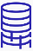







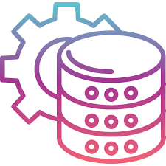
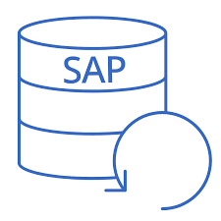

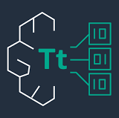








Proposed Technical Solution Architecture
SOURCES
DATA INGESTION
DATA STORAGE & PROCESSING
CONSUMPTION
3b
3c
1
2
4
GLUE Crawler
GLUE
Data Catalog
GLUE Crawler
ATHENA
On-prem MPP DW
SCT
DMS
S3 Landing+ Raw Data
GLUE (ETL)
S3 Trusted Data
OPENSEARCH
BEDROCK AI
BYOT-
POWER BI
QUICKSIGHT
MDM
Native Integration
Native Integration
SAP HANA
3a
REDSHIFT (Curated Data)
TITAN Embedding
SAGEMAKER
Q
MONITORING, SECURITY & GOVERNANCE
5

Slide 11
Solution Architecture Layer/Component wise articulation (1/2)
Architecture Reference | Architecture Description
1. Sources | 3 source systems are recognized On-premise MPP DW (assumption Netezza, Teradata or Greenplum) MDM (assumption Oracle or SQL DB) SAP HANA
2. Data Ingestion | AWS Schema Conversion Tool (SCT) provides native connectivity/ schema conversion for the MPP DW and MDM system identified above. SCT is part of the AWS Database Migration Service (DMS) and is preferred when conversion from one database format to other is required and heavy workloads are involved. Invoke SAP RFC to extract SAP HANA data using SAP PyRFC library and AWS Glue
3a. Data Storage & Processing (Data Lake and Data Warehouse) | AWS S3 service is used to land and store raw data. Data will be further curated using data transformations using Glue. Amazon Redshift and Amazon S3 provide a unified, natively integrated storage layer of our Lake House architecture. Amazon Redshift stores highly curated, conformed, trusted data that’s structured into standard dimensional schemas, whereas Amazon S3 provides exabyte scale data lake storage for structured, semi-structured, and unstructured data. Data products can be curated and be made available for users via a range of techniques – data extracts, reports, API’s etc Redshift Spectrum enables Amazon Redshift to present a unified SQL interface that can accept and process SQL statements where the same query can reference and combine datasets hosted in the data lake as well as data warehouse storage. Amazon Redshift can query petabytes of data stored in Amazon S3 by using a layer of up to thousands of transient Redshift Spectrum nodes and applying the sophisticated query optimizations of Amazon Redshift.
3b. Data Storage & Processing (Metadata Catalog) | The AWS Glue Data Catalog is a centralized repository that stores metadata about the organization's data sets. It acts as an index to the location, schema, and runtime metrics of your data sources. The metadata is stored in metadata tables, where each table represents a single data store. You can populate the Data Catalog using a Crawler, which automatically scans your data sources and extracts metadata.

Slide 12
Solution Architecture Layer/Component wise articulation (2/2)
Architecture Reference | Architecture Description
3c. Generative AI Infrastructure (optional, not in base proposal) | We propose to provide infrastructure and select use cases (at an additional cost) to support SCM team with an AI assistant. The architecture for this as follows: Select data/metadata will be vectorised using Titan Embeddings and stored in AWS OpenSearch (which acts as a vector DB). This will act as the RAG Bedrock will be used to build AI applications using a range of foundational models available on AWS.
4. Consumption | Amazon Athena is an interactive query service that makes it simple to analyze data directly in Amazon S3 using standard SQL. QuickSight is proposed as the BI tool for reports, dashboards and scorecards. Reports will be provisioned using this tool Given that business users may be used to other BI tools (such as Power BI, Tableau etc), they can be provisioned on AWS Sagemaker is the service that will be enabled for data scientists to build, run, govern their AI/ML models Amazon Q will be the interface for the augmented AI assistant.
5. Monitoring, Security & Governance | AWS Lake Formation helps centrally govern, secure, and globally share data for analytics and machine learning. Allows management of fine-grained access control for the data lake data on Amazon S3 and its metadata in AWS Glue Data Catalog. AWS Identity and Access Management (IAM) is a web service that helps securely control access to AWS resources. With IAM, we can manage permissions that control which AWS resources users can access. IAM provides the infrastructure necessary to control authentication and authorization for AWS accounts. CloudWatch is a service that monitors applications, responds to performance changes, optimizes resource use, and provides insights into operational health. By collecting data across AWS resources, CloudWatch gives visibility into system-wide performance and allows users to set alarms, automatically react to changes, and gain a unified view of operational health. AWS CloudTrail is an AWS service that helps enable operational and risk auditing, governance, and compliance of AWS accounts. Actions taken by a user, role, or an AWS service are recorded as events in CloudTrail. AWS Cost Explorer: Visualize, understand, and manage AWS costs and usage over time. Use cost allocation tags in management console.

Slide 13
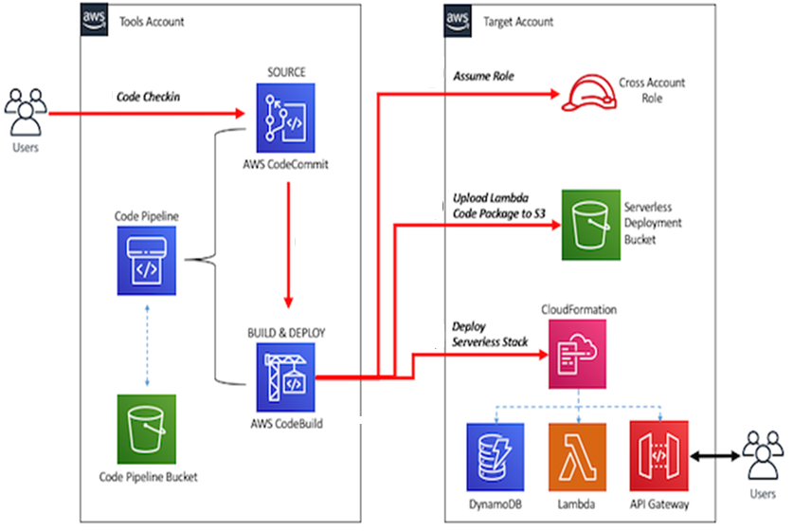
CI/CD Architecture
IAM role in Target Account that trusts the tools account and provides the required deployment-specific permissions. This IAM role is assumed by AWS CodeBuild in the tools account to carry out deployment.
AWS CloudFormation execution role to be assumed by AWS CloudFormation in the target account. This role has permissions to create API resources, such as a Lambda function and Amazon API Gateway, in the target account.
Build a CI/CD pipeline in the tools account using AWS CloudFormation, AWS CodePipeline, AWS CodeBuild, and AWS CodeCommit.
Notes:
https://aws.amazon.com/blogs/devops/building-a-ci-cd-pipeline-for-cross-account-deployment-of-an-aws-lambda-api-with-the-serverless-framework/

Slide 14
Estimation, Roadmap & Timeline, Pricing (with Detailed Work Breakdown Structure)
This is not a client facing slide as we are proposing a FP engagement
Estimation Category | Estimation (Person Days) | Estimation (% of Implementation Effort) | Assumptions
Requirements | 193 | 10% | Ingest/migrate 20 data entities 30 Glue jobs for data transformation/curation Data model with ~20 entities Catalog entities ~30 Data Products Provisioning ~10 BI reports 20 Dashboards 2
Architecture & Design | 270 | 13%
Development | 770 | 38%
Test Planning, Execution, Support | 418 | 21%
Documentation | 96 | 5%
Go-Live (plus operational processes) | 84 | 4%
Project Management | 183 | 9%
Implementation Effort | 2014 | 100%
Contingency | 201 |  | 10%. This is basically cost contingency
Hypercare | 160 |  | 4 weeks
Total | 2375
WBS

Slide 15
Estimation, Roadmap & Timeline, Pricing (with Detailed Work Breakdown Structure)
The implementation is expected to be completed in 7.5 months.
Hypercare of 1 month has been factored
 | Month1 |  | Month2 |  | Month3 |  | Month4 |  | Month5 |  | Month6 |  | Month7 |  | Month8 |  | Month9
Requirements & Backlog
Architecture
Design, Develop, Test
UAT
Go-Live
Hypercare

Slide 16
Estimation, Roadmap & Timeline, Pricing (with Detailed Work Breakdown Structure)
Pricing
The project will be executed on a fixed fee basis at a cost of $1,251,363.
Any taxes applicable, and travel upon client's request will be charged at actuals
Any travel on the request of the customer will be charged on actuals as per clients travel policy

Slide 17
Team Structure
Client Team
Vendor Team
Program Manager*
Program Sponsor
Project Manager
Scrum Master
SCM Business Analyst*
AWS Data Architect
QA Lead
DevOps Lead Engineer
Information Architects
UX Designer*
ETL Tech Lead
QA’s
Product Owner
Data Engineers
Data & Business SME’s
BI Tech Lead
User Acceptance Testers
AWS Admins
BI Engineers
*Located Onshore

Slide 18
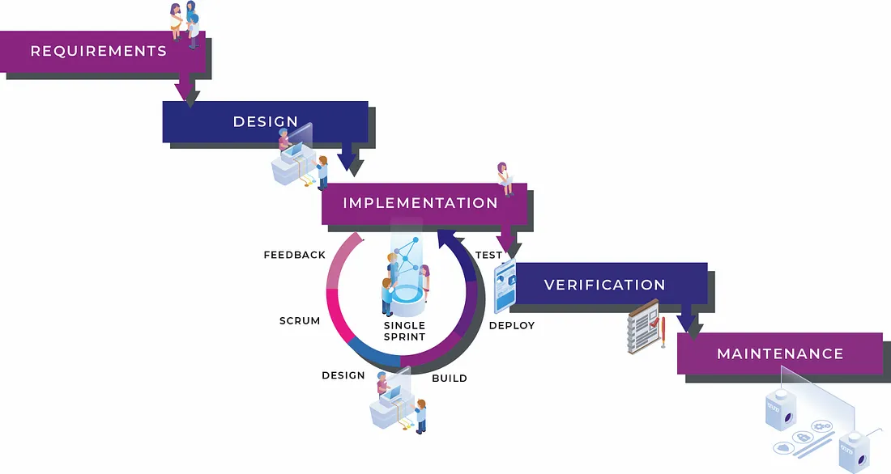
Execution Approach
A Hybrid execution approach which combines elements of waterfall and agile.
The requirements and architecture will be done in waterfall. Once completed, the project plan will be re-baselined
Implementation will be done using scrum methodology in a 2 week sprint
Std scrum ceremonies will be finalized along with the client stakeholders.

Slide 19
Thank You!

